Slide 1
Monte Carlo模拟
第四章 Monte Carlo积分

Slide 2
Monte Carlo模拟
第四章 Monte Carlo积分
简介
几何命中法 （Hit-or-Miss Method）
样本均值法 （Sample Mean Method）
方差缩减：重要性抽样（Variance Reduction: Importance Sampling Method）
方差缩减：相关法 （Correlation methods for variance reduction ）

Slide 3
简介
Monte Carlo 算法的重要应用领域之一：计算积分和多重积分
适用于求解：
被积函数、积分边界复杂，难以用解析方法或一般的数值方法求解；
被积函数的具体形式未知，只知道由模拟返回的函数值。
本章内容：
用Monte Carlo法 求 定积分 的几种方法：
均匀投点法、期望值估计法、重要抽样法、半解析法、…
（几何命中法）

Slide 4
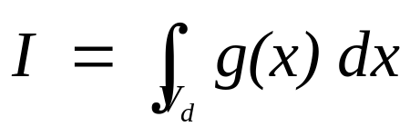
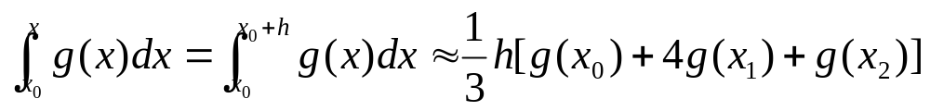
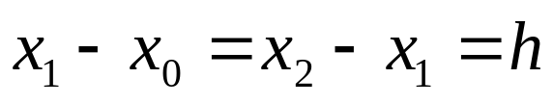
第四章 Monte Carlo积分
目的：计算一个定积分（一维或多维）
数值方法：
将积分区间分成n个子区间，用一些近似的方法计算各个子区间的积分值，然后对n个子区间的积分值求和
梯形法 ：对每个子区间用梯形近似
辛普森规则：用二次多项式在每个子区间拟合g(x)

Slide 5
第四章 Monte Carlo积分
数值方法存在的问题:
计算速度慢、精度低：
需计算的函数值的数目随着积分维数急剧增长
若积分维数d=10, 各方向分点数目n=50, 则需计算函数值的数目：~n^{d} = 50¹⁰
不恰当的子区间划分将导致不能很好地近似表示被积函数g(x)➔导致计算误差

Slide 6
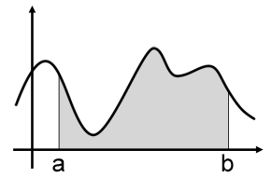
案例分析
蒙特卡罗方法的一个最著名应用就是求定积分。
蒙特卡罗方法的解法如下。如下图所示，我们在[a,b]之间取一个数x，那么我们可以粗略地将f(x)⋅(b−a) 来估计阴影部分的面积。

Slide 7
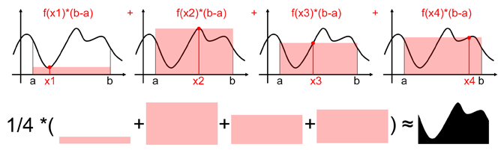
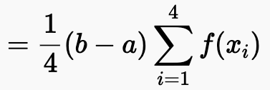
案例分析
当然，只用一个值进行估算，结果可能过于粗糙，所以我们可以多取几个值，然后用多个结果估计值的平均值作为最终的结果。如下图所示，取4个值进行估计：
可以预见，取4个值进行估计时，结果将更加准确。当进行估计的值个数越多时，最终结果将越接近真实值。

Slide 8
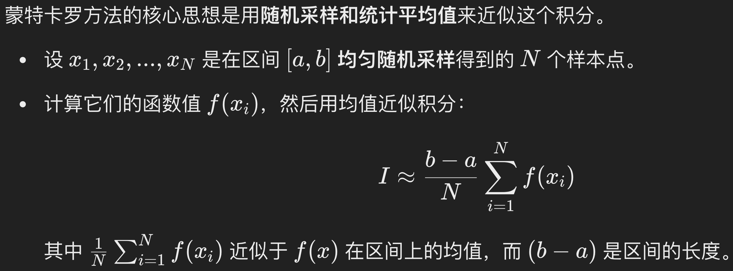
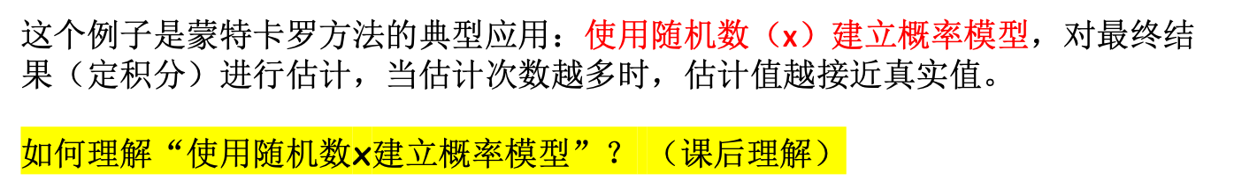
案例分析
Step1: 随机抽样
Step2: 统计平均值

Slide 9
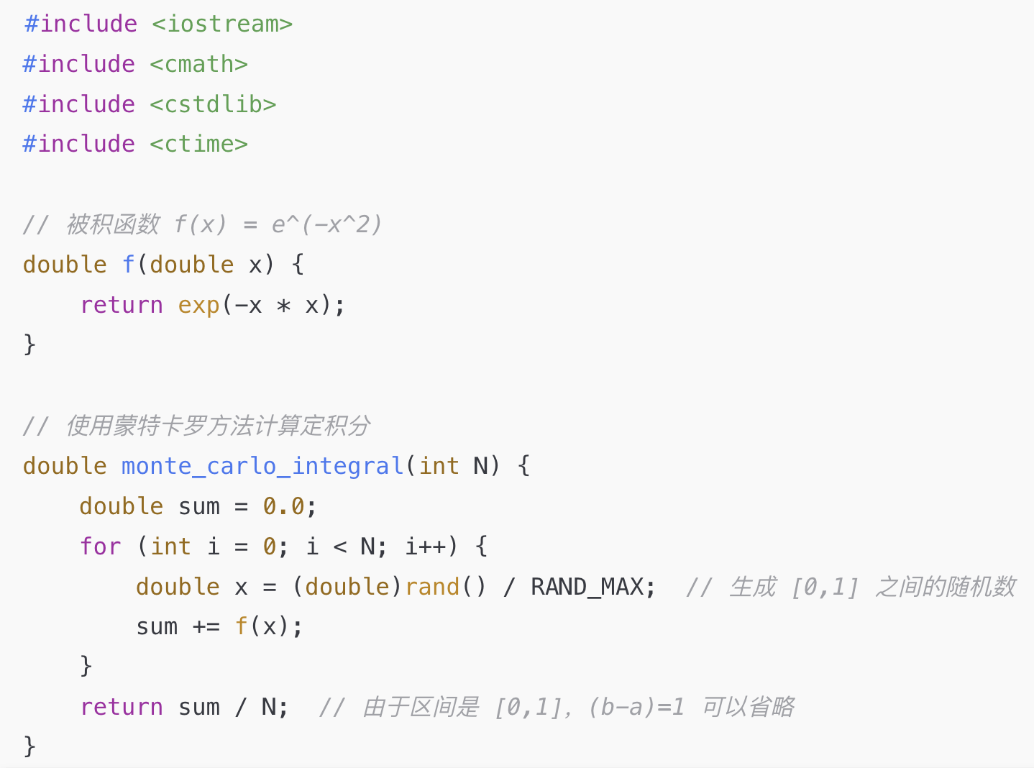
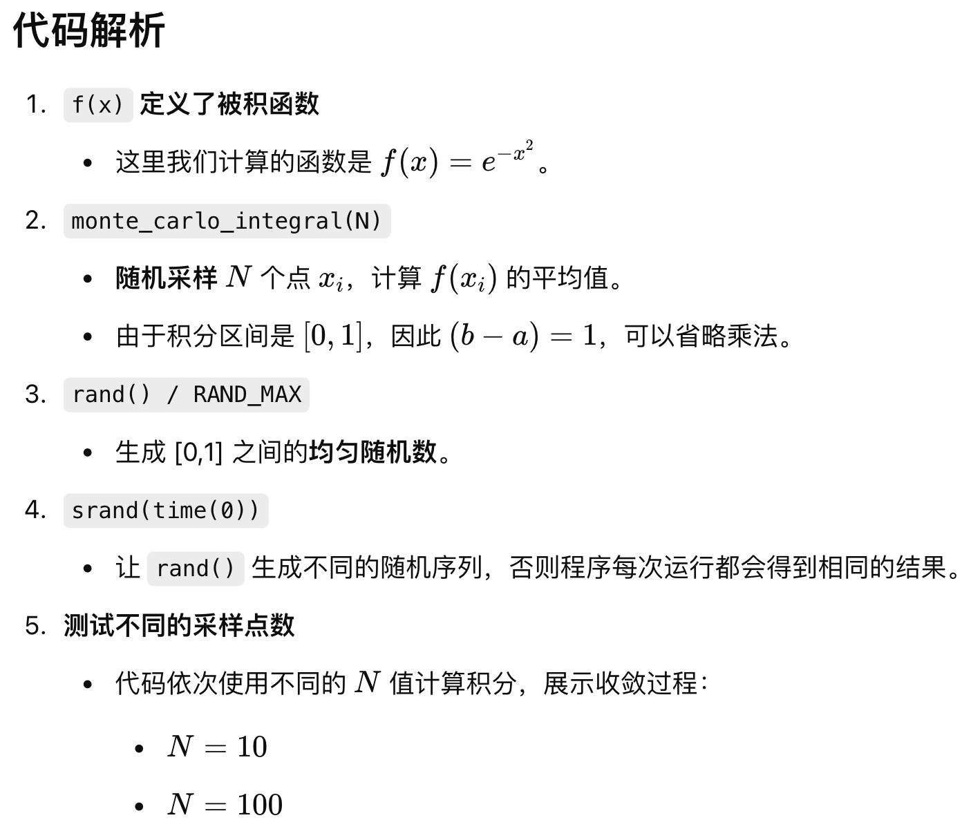
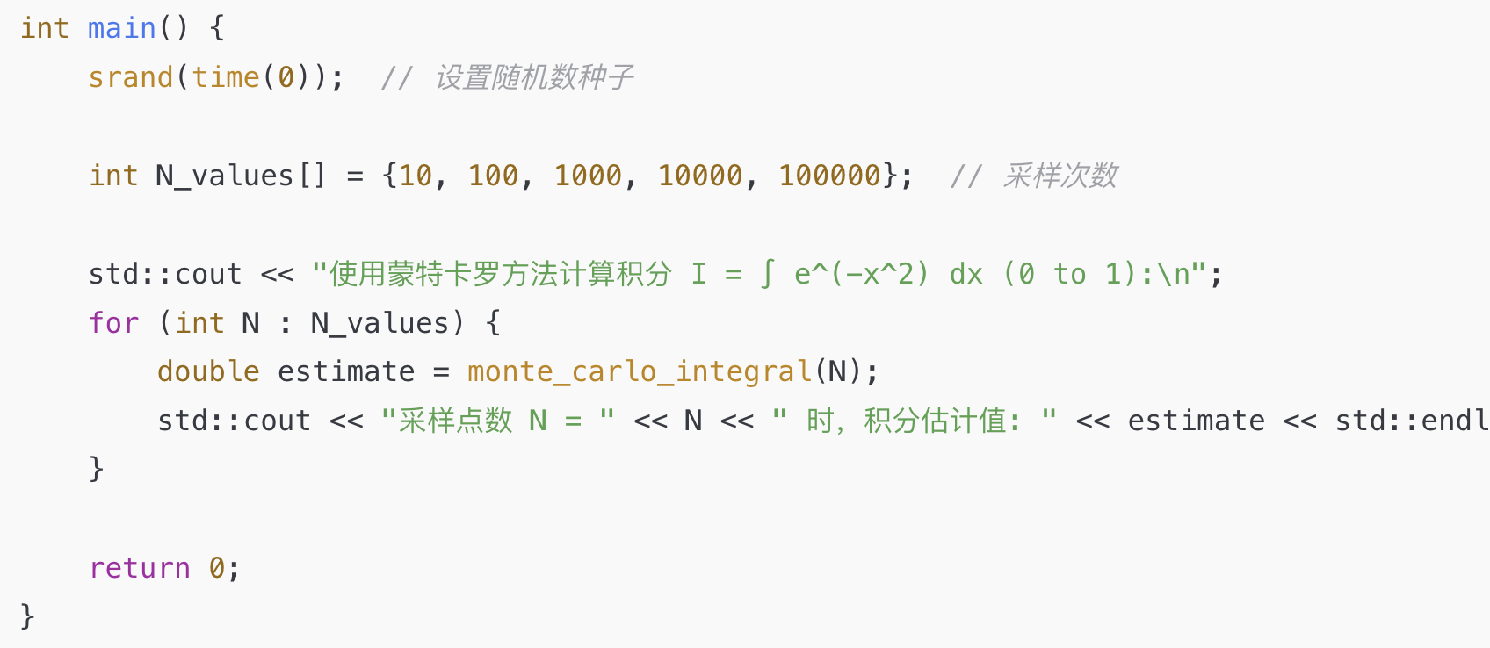
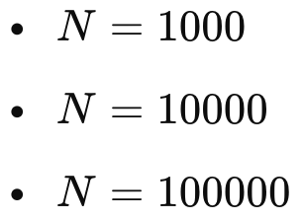
C++代码实现

Slide 10
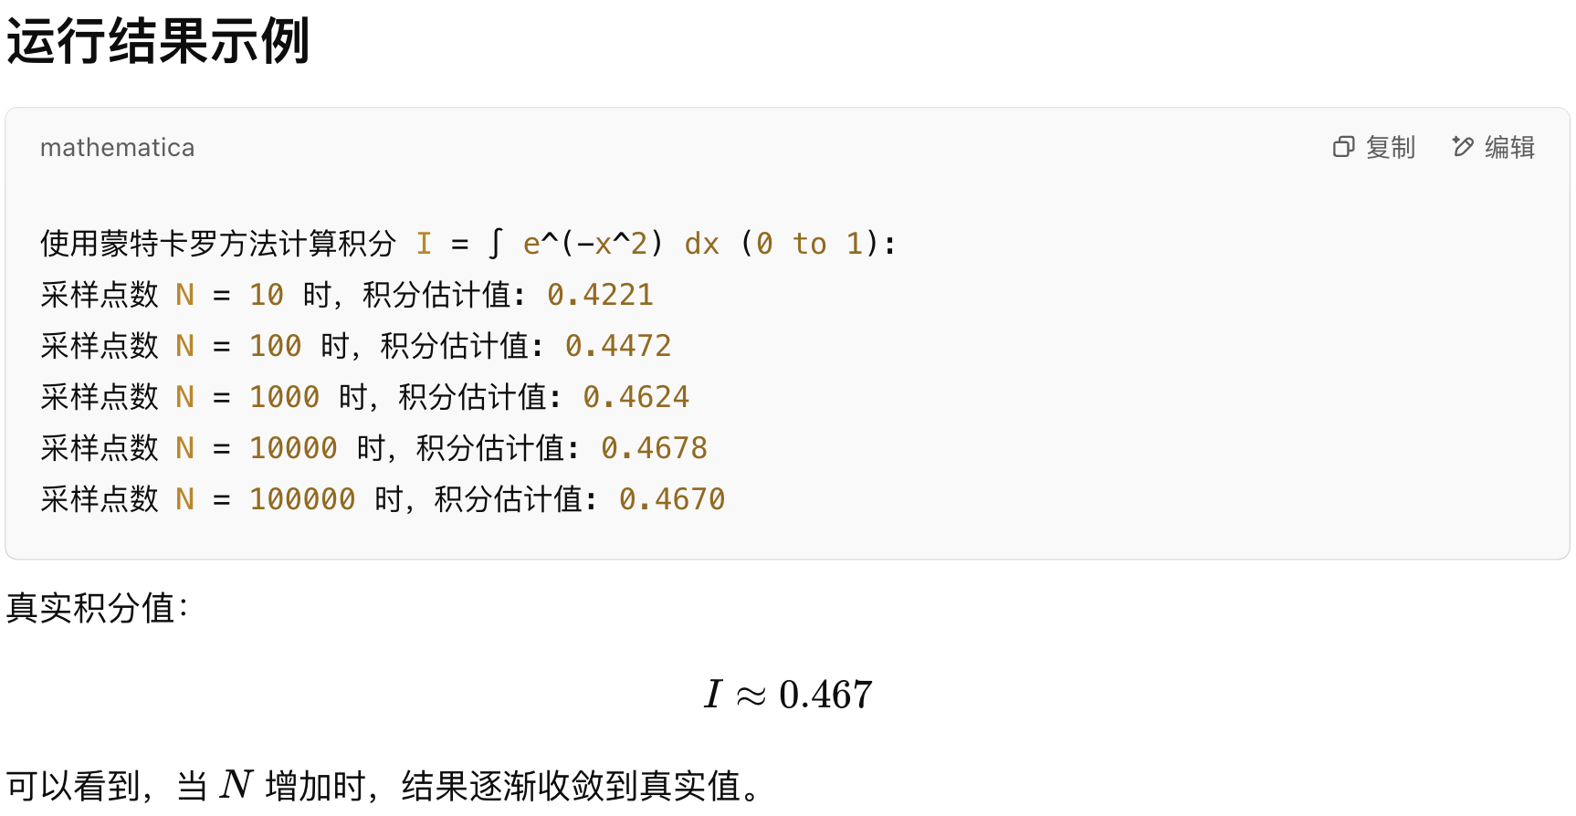
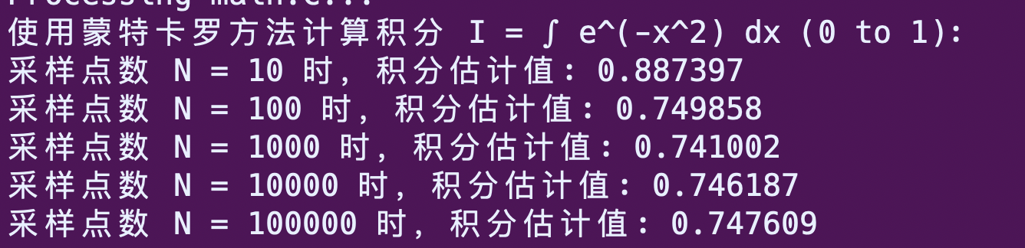
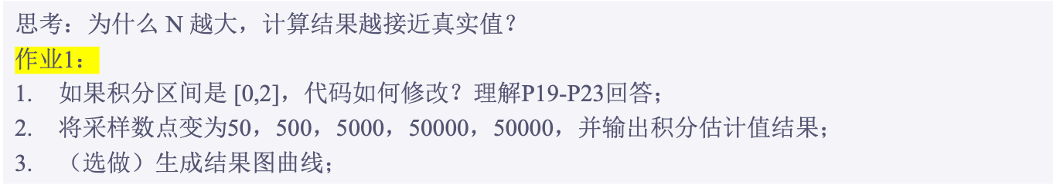
C++代码实现
I～0.747

Slide 11
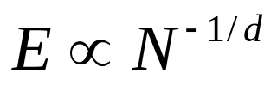
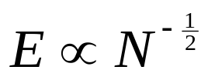

第四章 Monte Carlo积分
Monte Carlo方法可用于计算任何的d重积分
两种方法计算：随着维度d — 重积分的误差比较
传统确定性数值积分方法（如 Simpson 法）
Monte Carlo 积分
purely statistical,
not rely on the dimension !
高维下（d >> 3 ） Monte Carlo 更优
Notes:
传统确定性数值积分方法（如 Simpson 法）随着维度 ddd 增长，误差收敛极其缓慢；
Monte Carlo 积分 的收敛速率与维度无关，在高维积分时反而更加高效

Slide 12
Monte Carlo模拟
第四章 Monte Carlo积分方法
简介
几何命中法 （Hit-or-Miss Method）
样本均值法 （Sample Mean Method）
方差缩减：重要性抽样（Variance Reduction: Importance Sampling Method）
方差缩减：相关法 （Correlation methods for variance reduction ）

Slide 13
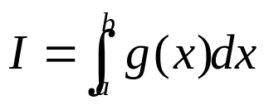

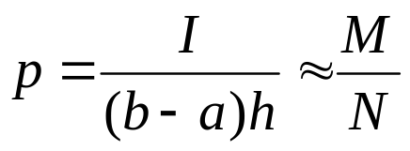
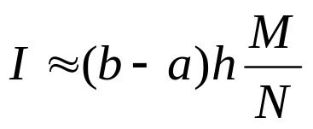
1. 几何命中法、Hit-or-Miss Method
定积分求值
h
X
X
X
转化成在矩形区域 [a,b]×[0,g_{max}] 中命中点的概率：
X
X
X
O
O
O
O
O
O
O
随机点位于区域内的概率
a
b
N : 总点数
M : 位于区域内的点数

Slide 14
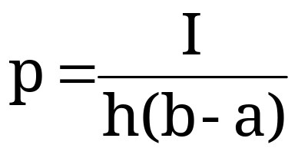
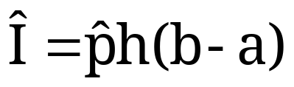

1. 几何击中法，Hit-or-Miss Method
从矩形区域均匀采样
[a,b]x[0,h]
我们位于曲线下方的概率是
因此，如果我们可以估算 p，我们就可以估算 I：
其中 是 p的估计

Slide 15
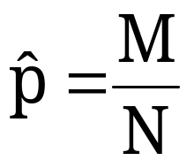
1. Hit-or-Miss Method
我们很容易评估p:
throw N “uniform darts” at the rectangle
let M be the number of times you end up under the curve y=g(x)
let

Slide 16


1. Hit-or-Miss Method
Start
Set N : large integer
M = 0
h
X
X
X
X
X
Loop
N times
Choose a point x in [a,b]
X
O
O
O
Choose a point y in [0,h]
O
O
O
O
a
b
if [x,y] reside inside then M = M+1
I = (b-a) h (M/N)
End

Slide 17
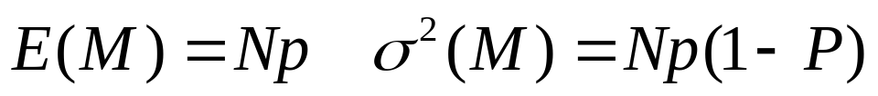
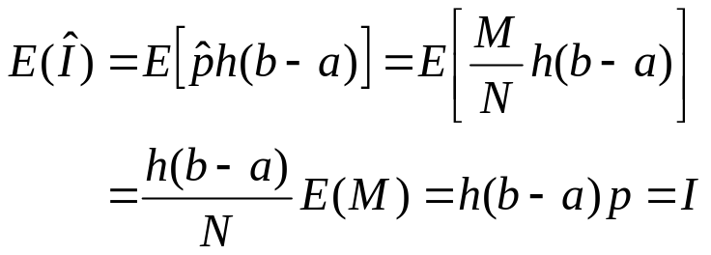
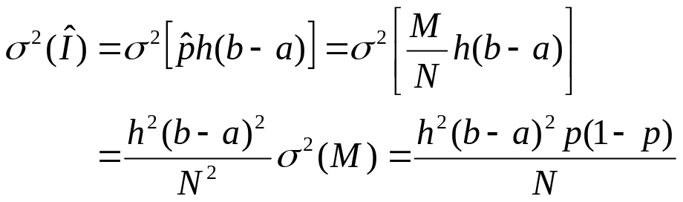
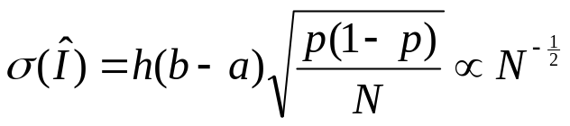
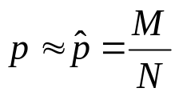
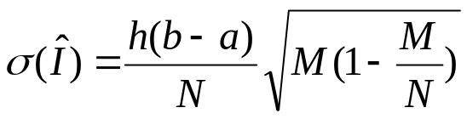
1. Hit-or-Miss Method
Error Analysis of the Hit-or-Miss Method
It is important to know how accurate the result of simulations are
note that M is binomial(M,p)

Slide 18
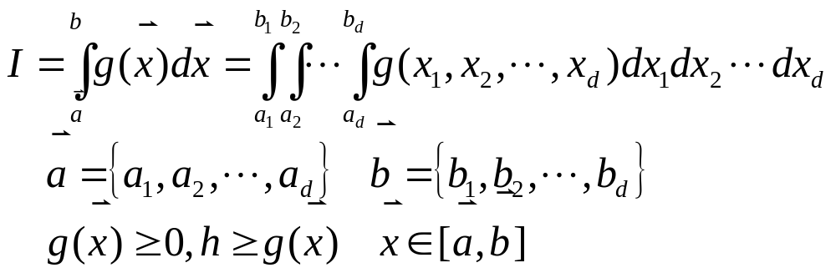
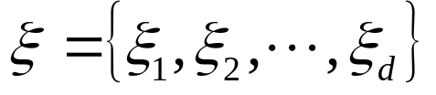


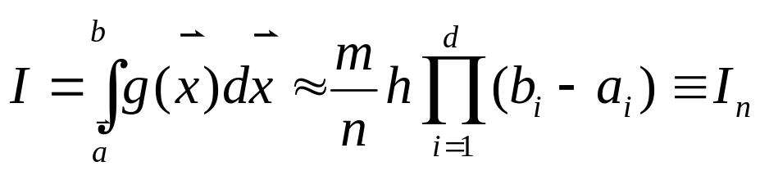
1. Hit-or-Miss Method
推广到多重积分：
区间
内均匀分布的随机数
η=hr : 区间[0,h]内均匀分布的随机数
选取n组
，若其中满足g(ξ)>η的共有m组

Slide 19
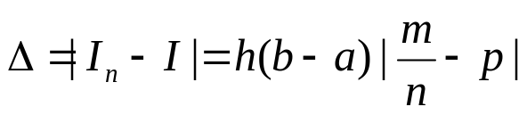
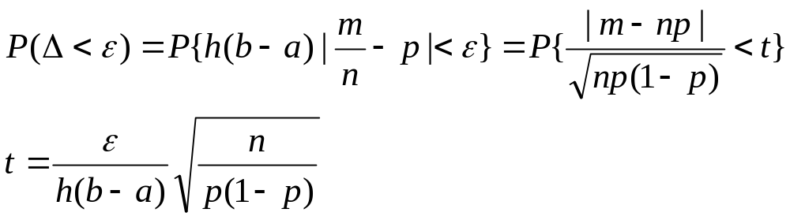
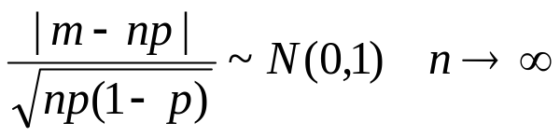
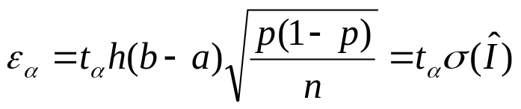
1. Hit-or-Miss Method
积分结果的置信水平：
对于任意给定的正数ε，怎样才能保证积分计算值I_{n}与真值I之差的绝对值Δ小于ε的概率大于α(0< α<1)
根据中心极限定理

Slide 20
Monte Carlo模拟
第四章 Monte Carlo积分
Hit-or-Miss Method
Sample Mean Method
Variance Reduction: Importance Sampling Method
Correlation methods for variance reduction

Slide 21
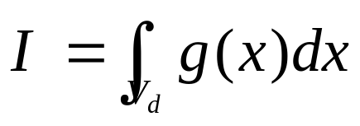
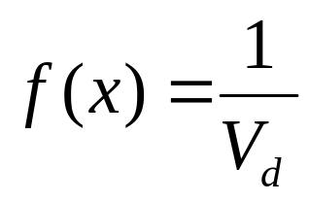
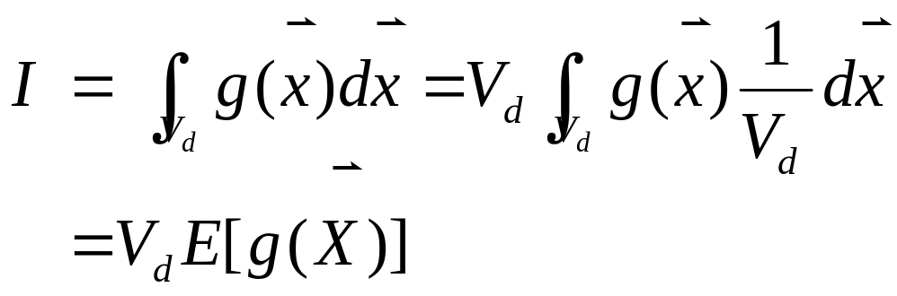
2. Sample Mean Method
设欲求的d-重积分为
令X 为积分域V_{d}上均匀分布的随机向量，其概率密度函数为：

Slide 22
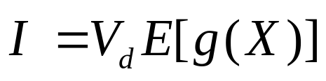
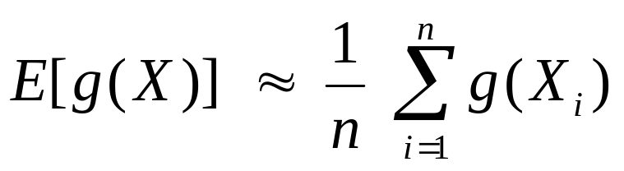
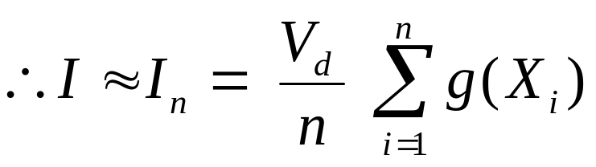
2. Sample Mean Method
X 在积分域V_{d}上均匀分布
产生容量为n的X的随机样本X_{i},并计算g(X_{i}),则根据大数定理，当n足够大时

Slide 23
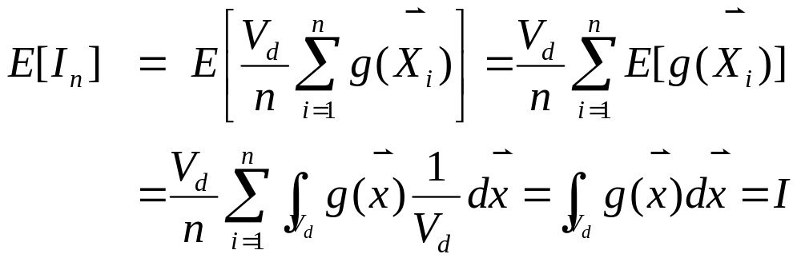
2. Sample Mean Method
误差分析：
This estimator is “unbiased”:

Slide 24
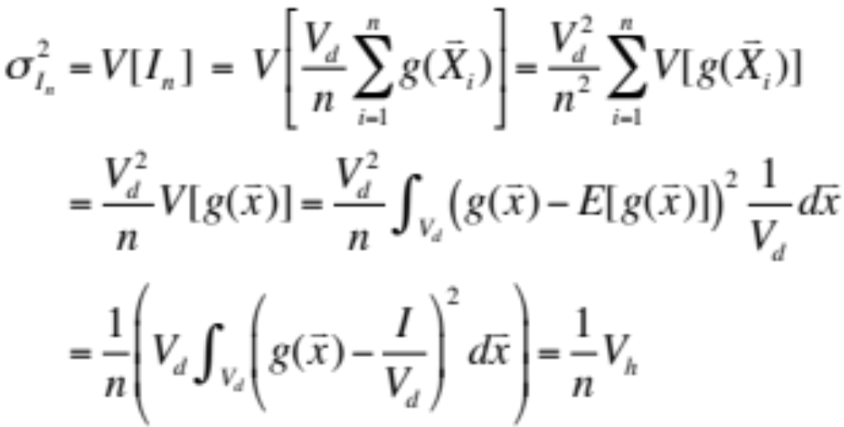
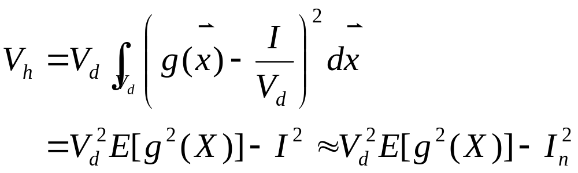
2. Sample Mean Method
Variance of this estimator:

Slide 25
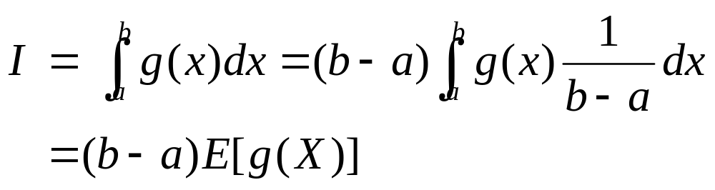
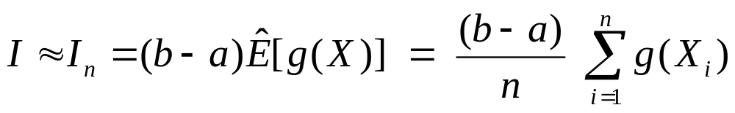
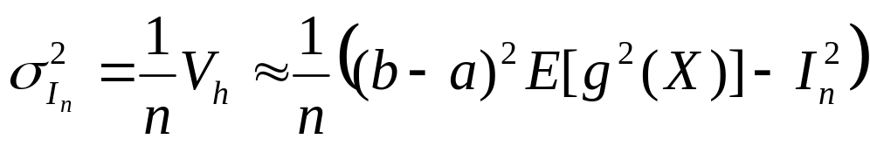
2. Sample Mean Method
一维积分的情况：

Slide 26
2. Sample Mean Method
Start
Set N : large integer
s = 0
Loop
N times
x_{n} = (b-a) u_{n} + a
y_{n} = g(x_{n})
s = s + y_{n}
Estimate mean I_{n}=s/N
End

Slide 27
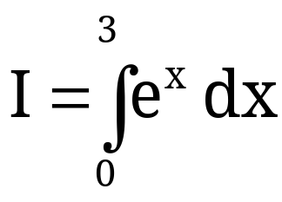
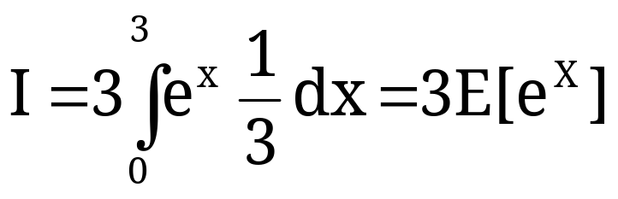
2. Sample Mean Method
Example:
(we know that the answer is e³-1 19.08554)
write this as
where X~unif(0,3)

Slide 28

2. Sample Mean Method
write this as
where X~unif(0,3)
estimate this with
where X₁, X₂, …, X_{n} are n independent unif(0,3)’s.

Slide 29

2. Sample Mean Method
Simulation Results: true = 19.08554, n=100,000
Simulation
1 19.10724
2 19.08260
3 18.97227
4 19.06814
5 19.13261

Slide 30



2. Sample Mean Method
Comparison of Hit-and-Miss and Sample Mean Monte Carlo
Let be the hit-and-miss estimator of I
Let be the sample mean estimator of I
Then

Slide 31
2. Sample Mean Method
Comparison of Hit-and-Miss and Sample Mean Monte Carlo
Sample mean Monte Carlo is generally preferred over Hit-and-Miss Monte Carlo because:
the estimator from SMMC has lower variance
SMMC does not require a non-negative integrand (or adjustments)
H&M MC requires that you be able to put g(x) in a “box”, so you need to figure out the max value of g(x) over [a,b] and you need to be integrating over a finite integral.

Slide 32
Monte Carlo模拟
第四章 Monte Carlo积分
Hit-or-Miss Method
Sample Mean Method
Variance Reduction: Importance Sampling Method
Correlation methods for variance reduction

Slide 33

3. Variance reduction: Importance Sampling Method
Sample mean method:
减小积分误差的方法：
增大抽样的次数n；
减小方差V_{h}

Slide 34
3. Variance reduction: Importance Sampling Method
Reducing error
*100 samples reduces the error order of 10
Reducing variance → Variance Reduction Technique
The value of variance is closely related to how samples are taken
Unbiased sampling
Biased sampling
More points are taken in important parts of the population

Slide 35


3. Variance reduction: Importance Sampling Method
If we are using sample-mean Monte Carlo Method
Variance depends very much on the behavior of g(x)
g(x) varies little → variance is small
g(x) = const → variance=0
Evaluation of a integral
Near minimum points → contribute less to the summation
Near maximum points → contribute more to the summation
More points are sampled near the peak →”importance sampling strategy”

Slide 36

3. Variance reduction: Importance Sampling Method
Importance sampling method
Basic idea
Put more points near maximum
Put less points near minimum
c
f(x)
X的概率密度函数为f(x)
g(x)

Slide 37



3. Variance reduction: Importance Sampling Method
设欲求的d-重积分为
令f(x)为积分域V_{d}上随机向量X的概率密度函数

Slide 38


3. Variance reduction: Importance Sampling Method
So, we will estimate I by estimating E[h(X)] with
where X₁, X₂, …, X_{n} is a random sample from the f(X) distribution.

Slide 39

3. Variance reduction:Importance Sample Method
误差分析：
This estimator is “unbiased”:

Slide 40


3. Variance reduction:Importance Sample Method
Variance of this estimator:

Slide 41


3. Variance reduction:Importance Sample Method
一维积分的情况：

Slide 42
3. Variance reduction:Importance Sample Method
Start
Set N : large integer
s = 0
Loop
N times
Generate x_{n} according to f(x)
h_{n} = g (x_{n}) / f ( x_{n})
Add h_{n} to s
I =s₁/N
End

Slide 43
Monte Carlo模拟
第四章 Monte Carlo积分
Hit-or-Miss Method
Sample Mean Method
Variance Reduction: Importance Sampling Method
Correlation methods for variance reduction

Slide 44
4. Correlation methods for Variance reduction
Correlation method:
Use correlated points in the sampling to reduce the variance of the integrand and improve the efficiency of the estimation
Control variates
Antithetic variables

Slide 45

4. Correlation methods for Variance reduction
Control variates
f(x): Control variate for g(x), must satisfy:
Simple enough to allow analytical integration
Should mimic g(x) to absorb most of its fluctuation
f(x) ~ g(x)

Slide 46
4. Correlation methods for Variance reduction

Slide 48
第九章 Monte Carlo积分
Hit-or-Miss Method
Sample Mean Method
Variance Reduction Technique
Variance Reduction using Rejection Technique
Importance Sampling Method

Slide 49





Variance Reduction Technique
Introduction
Monte Carlo Method and Sampling Distribution
  Monte Carlo Method : Take values from random sample
  From central limit theorem,
  3σ rule
  Most probable error
Important characteristics

Slide 50


Variance Reduction Technique
Introduction
Reducing error
  *100 samples reduces the error order of 10
  Reducing variance → Variance Reduction Technique
The value of variance is closely related to how samples are taken
  Unbiased sampling
  Biased sampling
    More points are taken in important parts of the population

Slide 51

Variance Reduction Technique
Motivation
If we are using sample-mean Monte Carlo Method
  Variance depends very much on the behavior of ρ(x)
    ρ(x) varies little → variance is small
    ρ(x) = const → variance=0
Evaluation of a integral
  Near minimum points → contribute less to the summation
  Near maximum points → contribute more to the summation
  More points are sampled near the peak →”importance sampling strategy”

Slide 52


2. Sample Mean Method
X₁, X₂, …, X_{n} iid -> g(X₁), g(X₂), …, g(X_{n}) iid
Let Y_{i}=g(X_{i}) for i=1,2,…,n
Then
and we can once again invoke the CLT.

Slide 53




2. Sample Mean Method
For n “large enough” (n>30),
So, a confidence interval for I is roughly given by
but since we don’t know , we’ll have to be content with the further approximation:

Slide 54



2. Sample Mean Method
By the way…
No one ever said that you have to use the uniform distribution
Example:
where X~exp(rate=2).

Slide 55
第九章 Monte Carlo积分
1.2 Hit-or-Miss Method
1.3 Sample Mean Method
2.1 Variance Reduction Technique
2.3 Variance Reduction using Rejection Technique
2.4 Importance Sampling Method

Slide 56




Variance Reduction Technique
Variance Reduction for Hit-or-Miss method
In the domain [a,b] choose a comparison function
w(x)
ρ(x)
X
X
X
X
X
O
O
O
O
O
O
O
a
b
Points are generated on the area under w(x) function
  Random variable that follows distribution w(x)

Slide 57




Variance Reduction Technique
Points lying above ρ(x) is rejected
w(x)
ρ(x)
X
X
X
X
X
O
O
O
O
O
O
O
a
b
q | 1 | 0
P(q) | r | 1-r

Slide 58





Variance Reduction Technique
Error Analysis
Hit or Miss method
Error reduction

Slide 59

Variance Reduction Technique
Start
Set N : large integer
w(x)
ρ(x)
N’ = 0
X
X
X
X
X
O
Loop
N times
Generate u₁, x= W-¹(Au₁)
O
O
O
O
O
O
Generate u₂, y=u₂ w(x)
a
b
If y<= f(x) accept value N’ = N’+1
Else : reject value
I = (b-a) h (N’/N)
End

